Slide 1

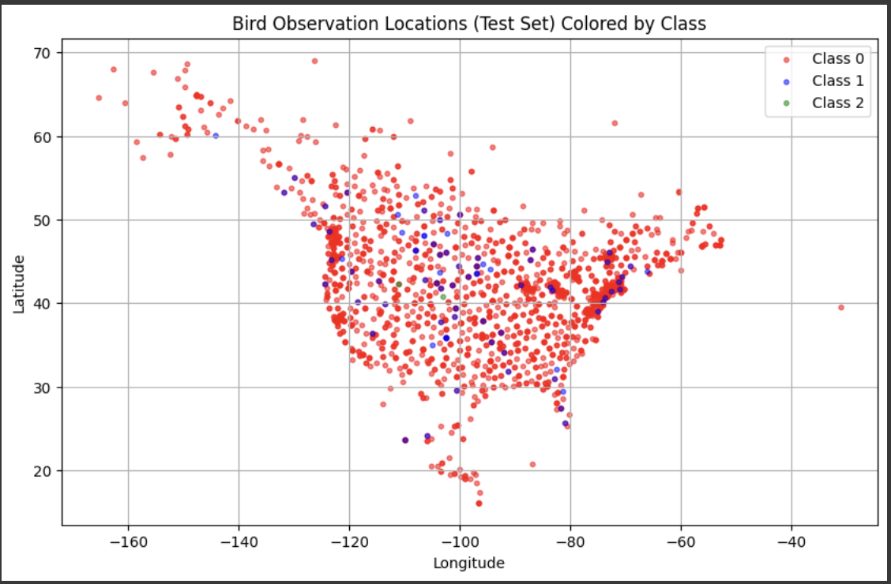
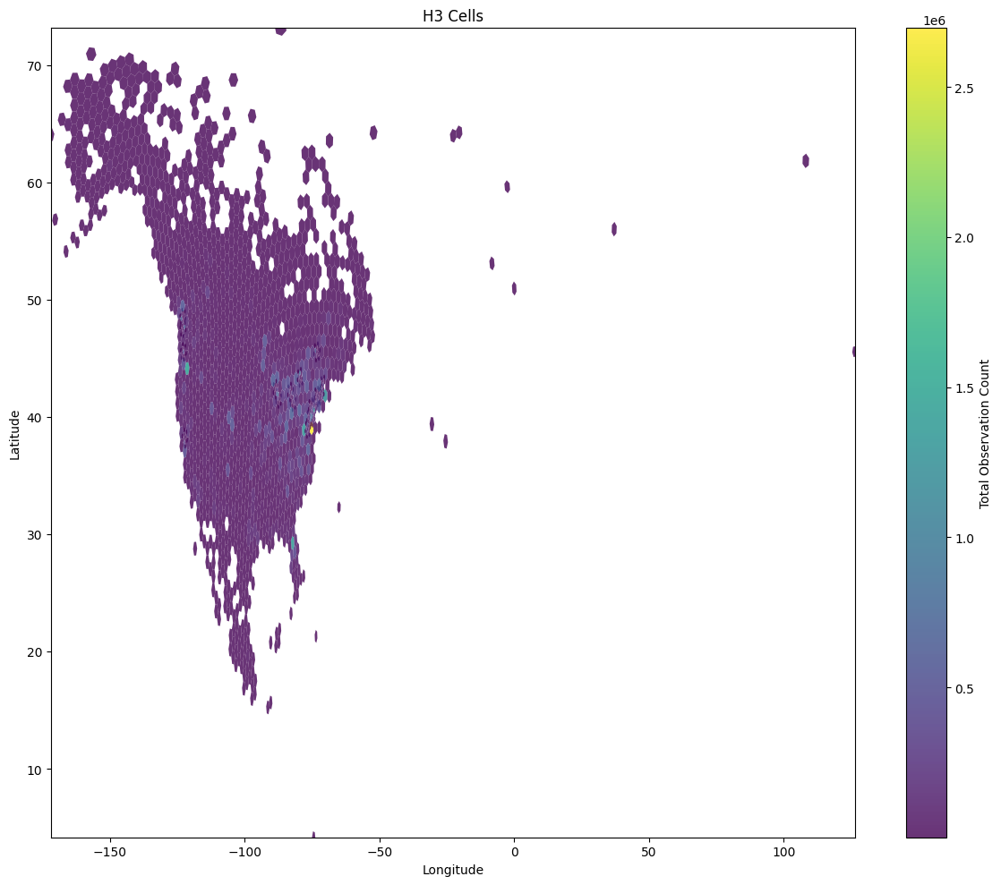
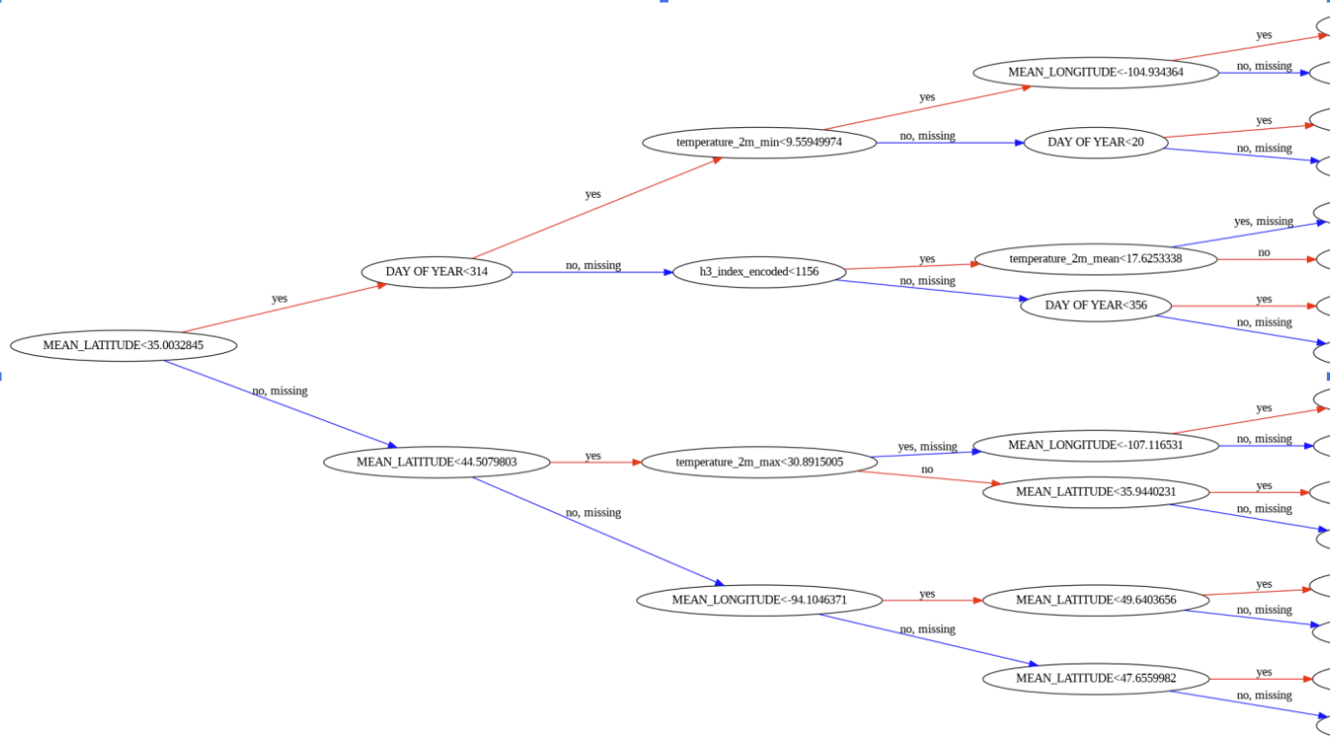
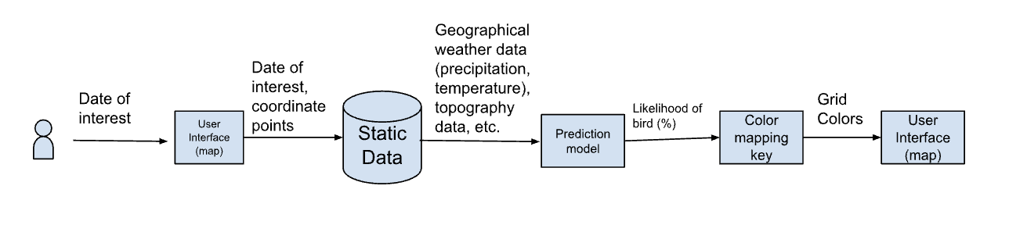
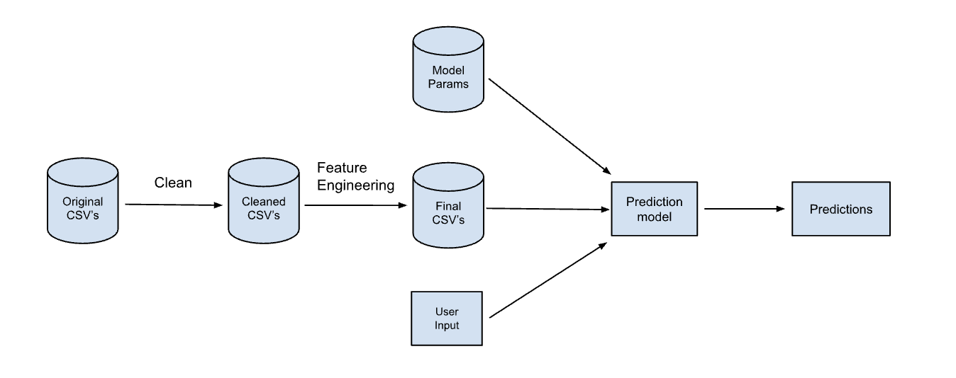

CSC-581
01-2252
The Bird Brains: Bird Migration Pattern Prediction
Jenna Chan
Background/Related Work
Simulation Environment
Implementation Details
Our project uses historical data to predict changes in bird migratory patterns and identify key causes, referencing the BirdFlow model from "BirdFlow: Learning Seasonal Bird Movements from eBird Data."
  The model's approach aligns with our project's goals to deduce movements from population-level data and integrate environmental factors like temperature and precipitation into migration forecasts.
  The validation methods, including calibration and average log-likelihood metrics, guide our approach to model tuning and validation.
  Opportunities exist to enhance the BirdFlow model by incorporating more explicit climate variables and refining loss functions to capture more biological nuances, potentially improving migration trend analysis in the context of climate change.
Our research also explores model transferability across different bird species and investigates the potential for applying similar methodologies to predict locations, analyze pit stop behavior, and respond to global changes.
Our system was designed to predict bird migration patterns and density levels based on weather and geospatial data. We began by preprocessing a dataset containing bird observations and meteorological variables using the Polars library. Temporal features such as year, month, day of year, and season were derived from the observation date. Due to the large amounts of data, we had to aggregate observations. Bird observation counts were binned into three categories (low, medium, high). Geospatial data was then represented using H3 cell indices, grouping together bird observation locations if they were within a certain distance of each other. For cells with high bird density, the cell would be split smaller. Then, we label-encoded the cells for model compatibility.
We tried two initial models, which were a neural network and a random forest, to classify bird density levels based on the engineered features. However, both models achieved only about 60% accuracy, largely due to class imbalance and limited representation of minority classes. To improve performance, we transitioned to a gradient boosting approach using XGBoost. This model was trained on a stratified train-test split with class-based sample weighting to address the imbalance in observation counts.
To further enhance prediction quality, we generated synthetic data for underrepresented classes and reweighted training samples accordingly. These adjustments significantly improved model performance, raising classification accuracy to approximately 95%. Experiments were evaluated using classification metrics such as precision, recall, and F1-score, confirming the effectiveness of our improved model. Overall, the system architecture and iterative modeling strategy proved successful in building a robust tool for bird migration and density prediction.
Figure 1. Visual output of our test set classified through our model. The classes 0,1,2 represent low, medium, and high bird densities, respectively.
Figure 3. First few layers (to hopefully somewhat still be legible) of the XGBoost model we ended up using.
Figure 2. Graph of the H3 cells showing density and groupings of bird observations.
Goals/Motivation
System Design Diagrams
Validation and Evaluation
Motivation
  Climate change significantly impacts bird migration, a critical ecological indicator
  Birds are vital ecosystem members
  Understanding migration patterns supports conservation efforts
  Machine learning can predict migration shifts under climate change, which can help wildlife services plan conservation strategies
Goals and Objectives
  Create ML system to forecast bird migration based on climate variables
  Identify correlations between temperature/precipitation and bird movements
  Develop map-based visualization showing migration pattern changes
  Implement data processing for 600GB dataset
The model achieves 94% accuracy, correctly predicting bird sightings. By using environmental and geographic data, it reliably identifies areas with bird activity, confirming its effectiveness in predicting where birds are located.
Figure 4. System design diagram for our front end architecture
Conclusions
Our project successfully predicts bird migration patterns using machine learning, showing strong correlations between climate variables and bird movements
The model effectively classifies bird observation density into low, medium, and high categories with good accuracy
Results support strategic conservation planning for changing migration patterns
While currently focused on American Robin in the Eastern U.S., our methodology can be expanded to include more species and broader geographic regions
Figure 5. System design diagram of our backend architecture
References
Affiliations
Dr. Franz Kurfess (Faculty Advisor)
Heisman, Rebecca. “A Brief History of How Scientists Have Learned about Bird Migration.” Audubon, 21 Feb. 2023, www.audubon.org/magazine/spring-2022/a-brief-history-how-scientists-have-learned-about#:~:text=1952,of%20Illinois%20at%20Urbana%2DChampaign.
Fuentes, Miguel, et al. “BirdFlow: Learning Seasonal Bird Movements from EBird Data.” Methods in Ecology and Evolution, vol. 14, no. 3, 31 Jan. 2023, pp. 923–938, https://doi.org/10.1111/2041-210x.14052.
Kranstauber, B., Bouten, W., van Gasteren, H., & Shamoun-Baranes, J. (2022). Ensemble predictions are essential for accurate bird migration forecasts for conservation and flight safety. Ecological Solutions and Evidence, 00, 3, e12158. https://doi.org/10.1002/2688-8319.12158
Ahmed, Hazem & Glasgow, Janice. (2012). Swarm Intelligence: Concepts, Models and Applications. https://doi.org/10.13140/2.1.1320.2568.
WANG, C., ZHANG, S., MA, T., XIAO, Y., CHEN, M. Z., & WANG, L. (2024). Swarm intelligence: A survey of model classification and applications. Chinese Journal of Aeronautics. https://doi.org/10.1016/j.cja.2024.03.019

